Slide 1
The Politics of Social Inequalities
Developing Research Questions and Visualizations
Example: Immigration and Political Participation

Slide 2
Overview and Outline
Questions and Concerns
Example: Immigration, Inequality, and Political Participation
From interest to research question
A general question
Theory
Operationalization and Data
Visualization

Slide 3

Any (technical) questions?
What does this error message mean?
Why won’t this work?
How can I do this?
How do I save images

Slide 4
Inequality, Migration Status, and political participation

Slide 5
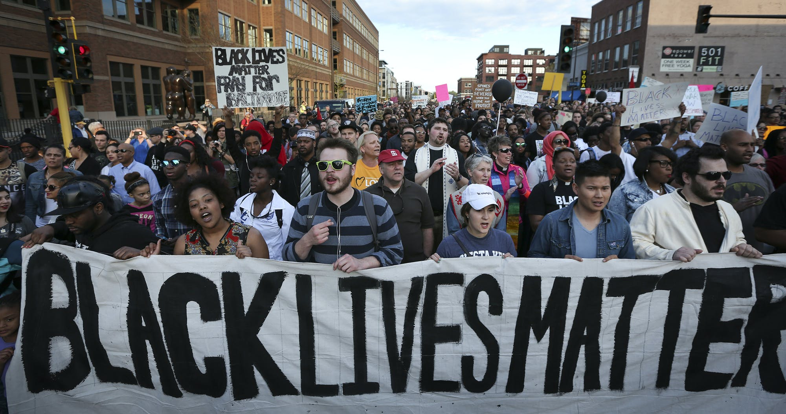

Slide 6
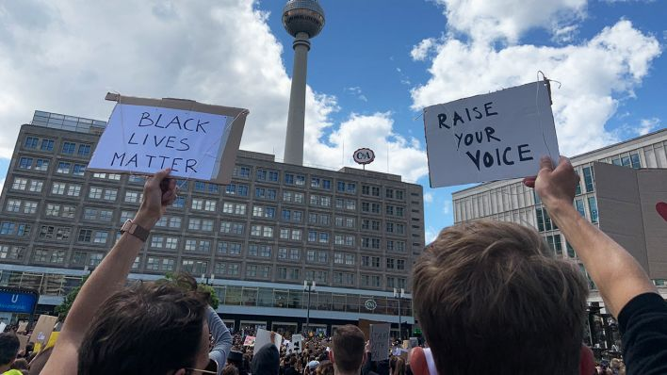
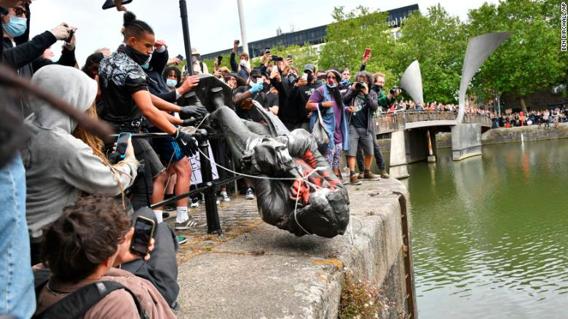
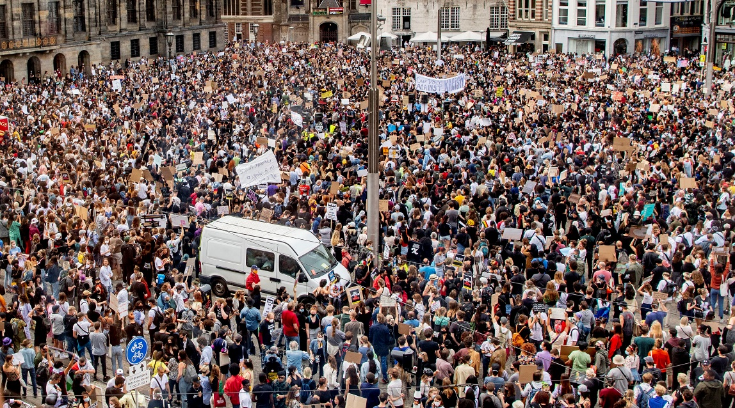
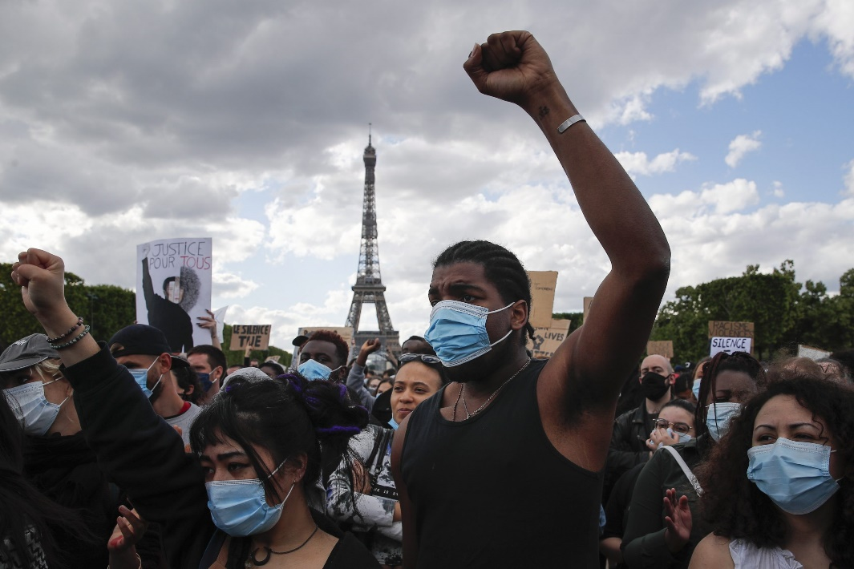

Slide 7
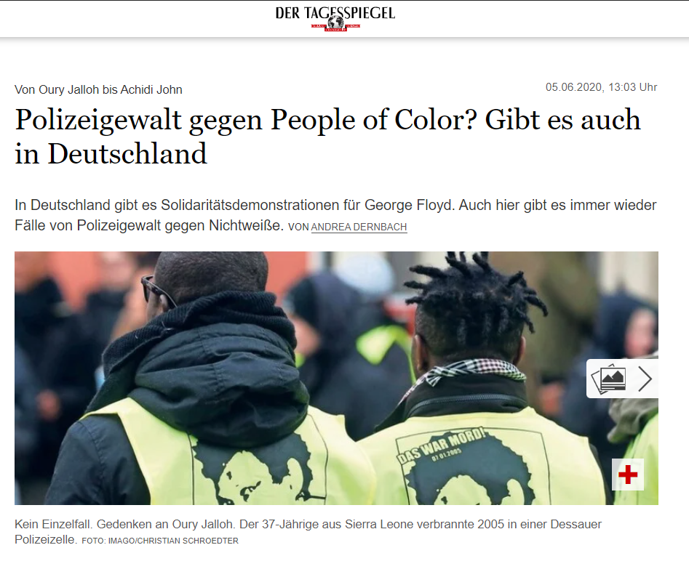
Many (overlapping) Dimensions of Inequality
Class
Labor market status
Income
Gender
Disability
Sexuality
Religion
Race and Ethnic Identity
Migrant Background
Notes:
https://www.tagesspiegel.de/politik/von-oury-jalloh-bis-achidi-john-polizeigewalt-gegen-people-of-color-gibt-es-auch-in-deutschland/25884422.html

Slide 8
Many (overlapping) Questions
Do immigrants participate less frequently in politics?
Does this behavior differ by the type of political action?
What drives these differences?
Legal and political rules
Social-Psychological Factors
Mechanisms
Does this relationship differ by country and context?

Slide 9
Some Existing Research I
Gallego, Aina. 2007. “Unequal Political Participation in Europe.” International Journal of Sociology 37(4): 10–25.
The fact that social stratification factors are closely related to different levels of political participation is a classical issue that has relevant normative as well as explanatory implications for the study of participation. Research on this topic has focused mainly on unequal participation in the United States and we know little about contemporary patterns in other contexts. This article uses data from the European Social Survey to explore the effect of various possible sources of inequality (gender, age, social class, education, income, ethnicity, and working status) on four political activities: voting, working with parties and action groups, attending demonstrations, and boycotting products. Overall, age, education, and social class emerge as the most common causes of distortion, while gender, membership in minorities, and occupational variables are less clearly related to participation. In conventional political activities the differences are more predictable in the direction of the disadvantaged, while demonstrators are in some respects undistinguishable from the general public. Finally, the fact that socioeconomic inequalities in turnout are unambiguously visible in most European countries stands in contrast to past research and deserves further attention.

Slide 10
Some Existing Research II
Wass, Hanna, André Blais, Alexandre Morin-Chassé, and Marjukka Weide. 2015. “Engaging Immigrants? Examining the Correlates of Electoral Participation among Voters with Migration Backgrounds.” Journal of Elections, Public Opinion and Parties 25(4): 407–24.
An increasing number of eligible citizens in North America and Europe were born outside of these countries. As remarked by Heath et al. [2011. “Ethnic Heterogeneity in the Social Bases of Voting at the 2010 British General Election.” Journal of Elections, Public Opinion and Parties 21 (2): 255–277], in the case that voters with migration background respond differently to established correlates of turnout, understanding the role of immigration-specific factors becomes particularly important. On the basis of individual-level register data from the 2012 Finnish municipal elections (n = 585,839), we examine whether the effect of socioeconomic status on turnout differs according to citizenship status and test which indicators of social and political integration boost participation among foreign-born voters. We find, in line with the different response model, that the impact of age and education is weaker among voters with migration background. In addition, having a native spouse and minor children, past eligibility and being born in a democratic country increase turnout among foreign-born voters, lending support for the assimilation, exposure and transferability models. Finally, the findings concerning the resistance model were opposite to our expectations. Older age at the time of immigration increases participation, but only among migrants born in a democratic country.

Slide 11
Some Existing Research III
Pettinicchio, David, and Robert de Vries. 2017. “Immigrant Political Participation in Europe.” Comparative Sociology 16(4): 523–54.
This paper compares participation in different forms of political action between natives, immigrants and non-citizen immigrants using data from thirteen European countries across six waves of the European Social Survey. The authors highlight problems associated with previous categorizations of political action, and find that when political action is disaggregated and relative participation between groups is examined, that immigrants’ patterns of participation are not substantially different from those of natives. When comparing citizen immigrants to non-citizen immigrants, previous research has suggested that citizenship acts as a “ticket” to non-institutional, unconventional, confrontational forms of political action. The authors’ findings instead suggest a more complicated relationship between immigrant/citizenship status and preferences for political action since citizenship may facilitate participation in both so-called institutional and extra-institutional activities depending on the context of action

Slide 12
From Interest to Research Design

Slide 13
1. Define your research question
Do immigrants participate less frequently in politics?
Does this behavior differ by the type of political action?
What drives these differences?
Legal and political rules
Social-Psychological Factors
Mechanisms
Does this relationship differ by country and context?

Slide 14
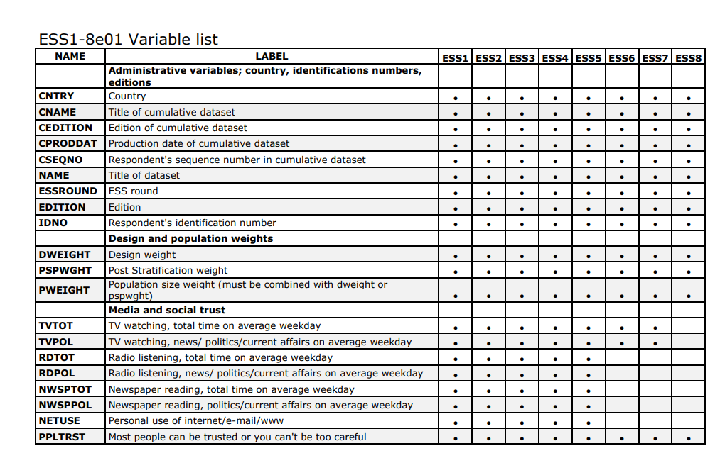
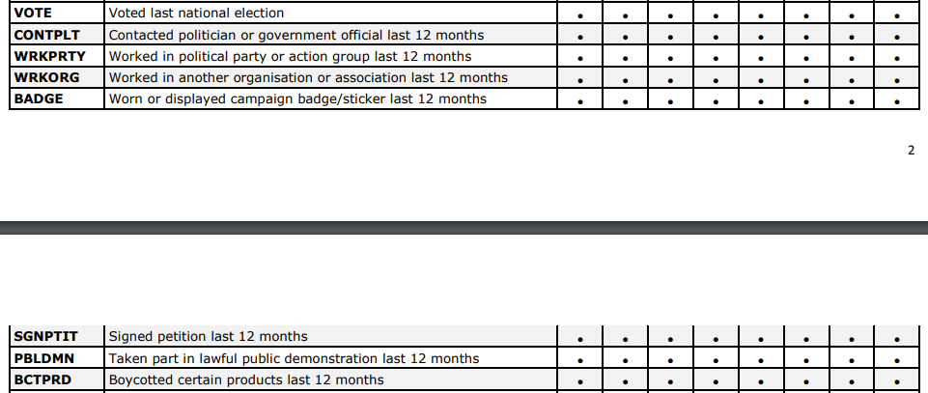
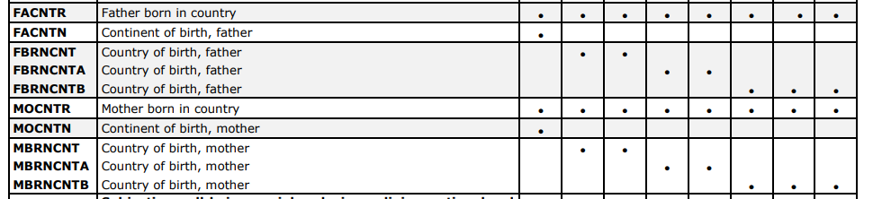
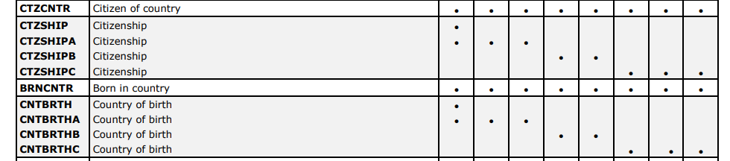
Find and Operationalize the Data
Example – European Social Survey
https://www.europeansocialsurvey.org/docs/cumulative/ESS_cumulative_variable_list.pdf
https://www.europeansocialsurvey.org/data/

Slide 15
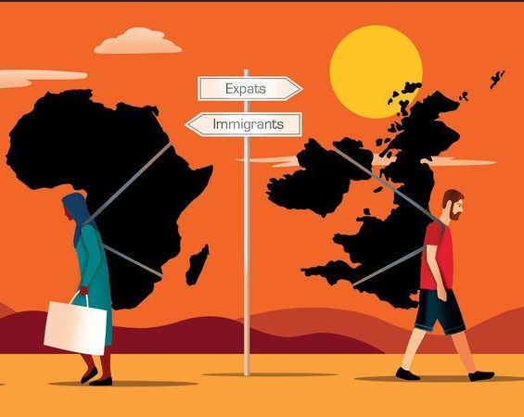
Operationalization and Theory I
What does it mean to be a migrant?
Born in the country or not?
Citizen or not?
Parents born in country or not?
Does the type of country matter?

Slide 16
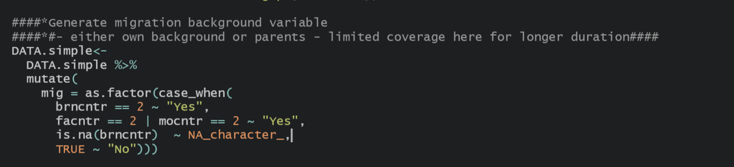
Operationalization and Theory II: Example Example Code: migration_inequality.R

Slide 17
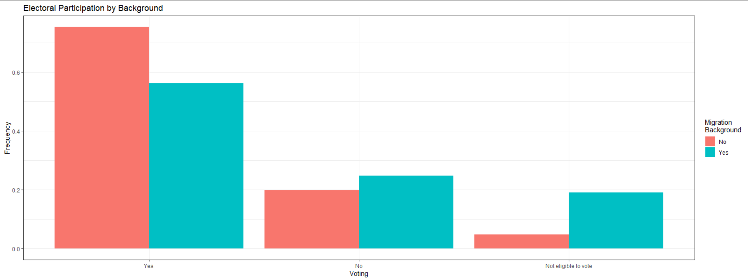
Exploring the data: Electoral Participation Example Code: migration_inequality.R

Slide 18
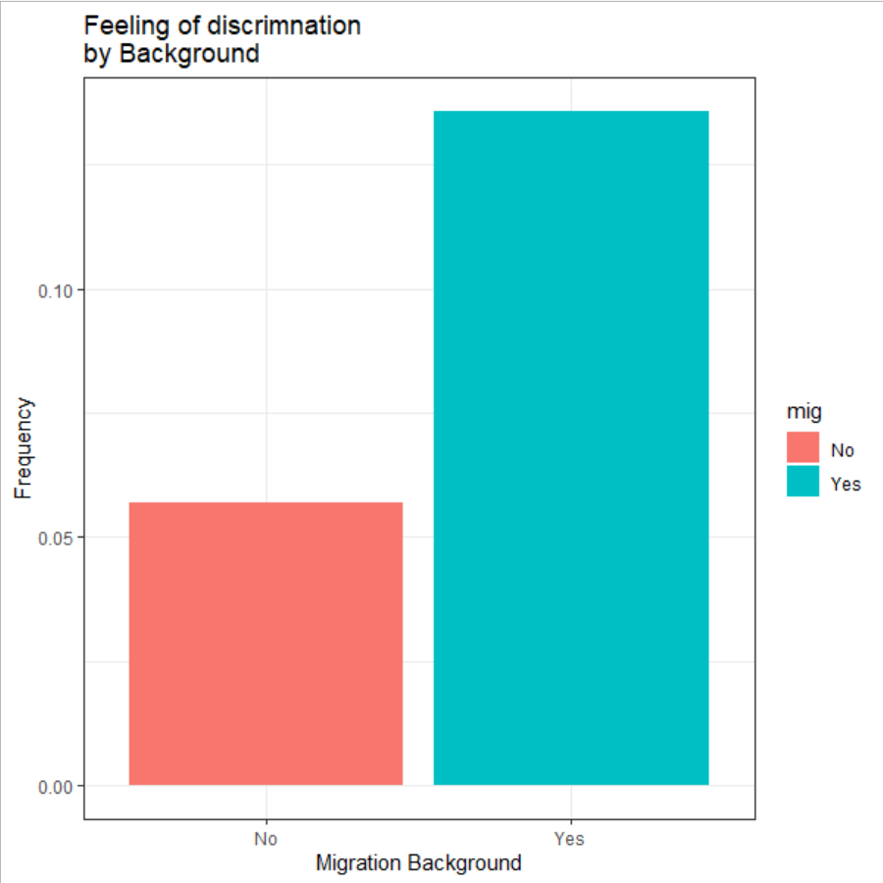
Exploring the data: Feeling Discriminated Example Code: migration_inequality.R

Slide 19
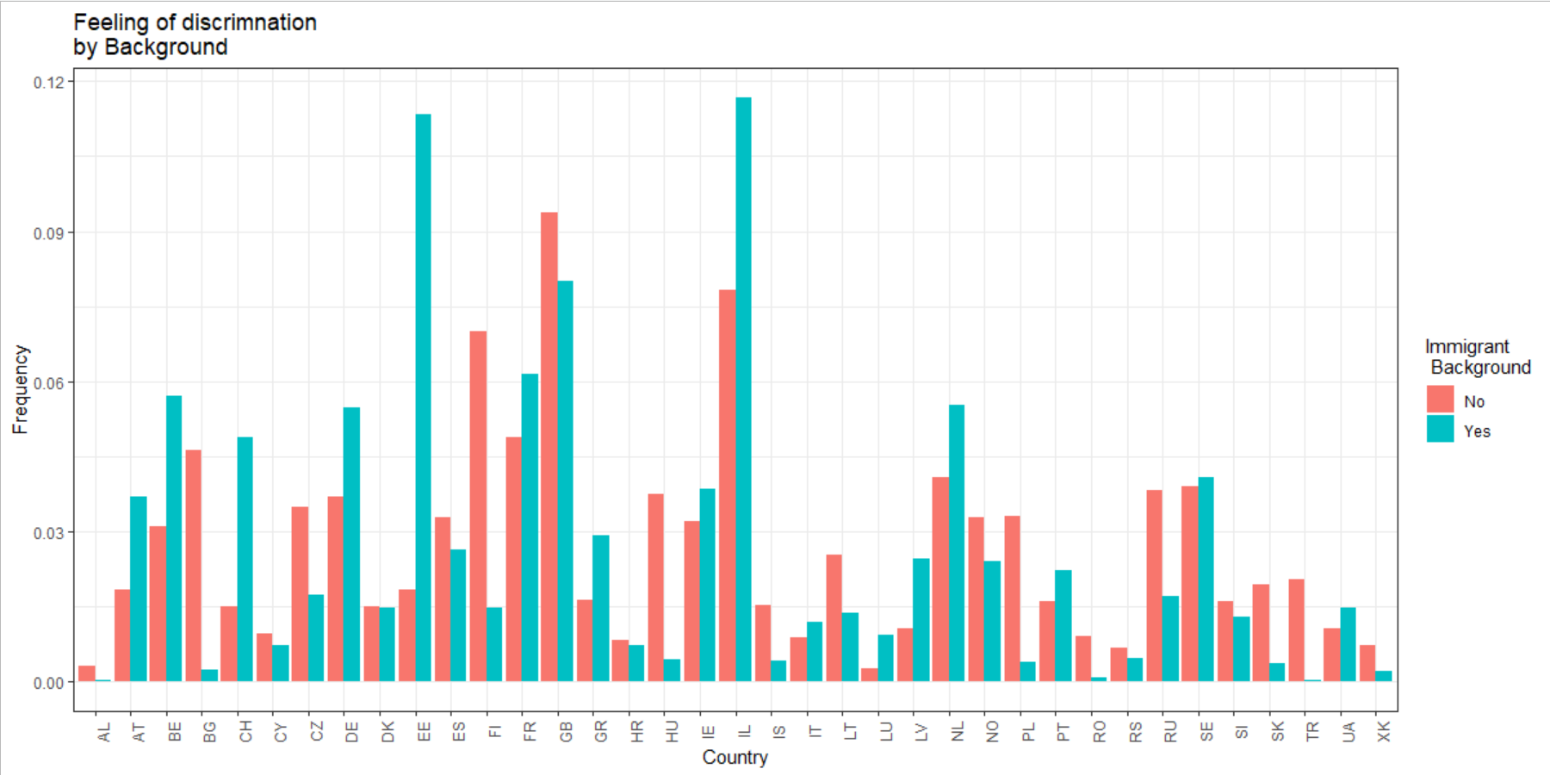
Exploring the data: Feeling Discriminated II Example Code: migration_inequality.R

Slide 20
How to move forward?
Do our operationalizations make sense?
What does it mean to be an immigrant?
How to capture ethnicity?
How to measure participation?
Intersectionality – Control variables and Interaction Effects
Correlational Models
Country and Context Characteristics

